Slide 1
Bangladesh----- A lost colony

Slide 2
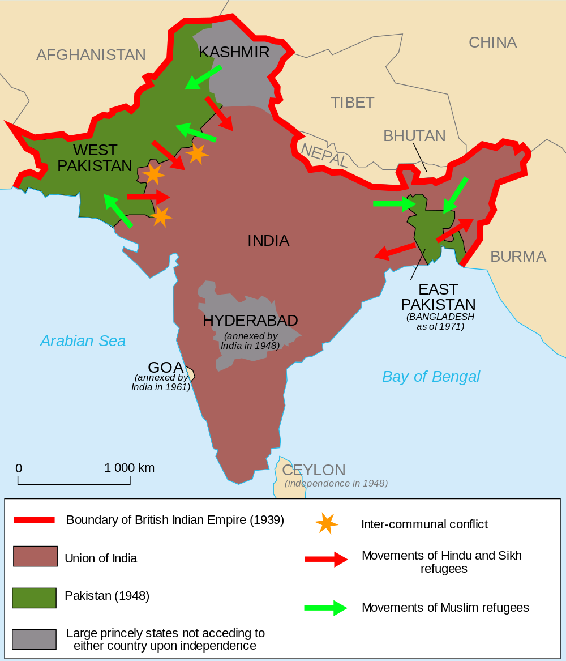

Slide 3
Causes of the separation
Failure of Muslim league leadership in East Pakistan
The conflict over language
Unity of Bengali Muslims and Hindus
Delay in constitution making
Presidential form of Government

Slide 4
Six point formula of Sheikh Mujeeb
Federal form of government
Defence and foreign affairs
Separate currencies
Fiscal policy
Foreign exchange earning
Separate para-military forces

Slide 5
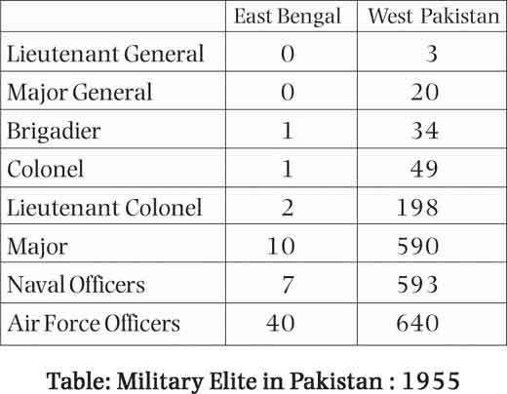
Role of ruling elite
Civil Services
Military hierarchy

Slide 6
Economic disparities between East and West
Economic growth policies of west Pakistan
Lucrative import licenses
1955-1960, 26% investment, 2.5 billion as compared to 8.9 billion
22 families control over economy
66% native industrial assets
80% banking assets
79% insurance assets

Slide 7
The failure in the enforcement of LFO, 1970
Constitution making within 120 days
modifications in LFO
The war of power between Bhutto and Mujeeb
Hijacking of Indian plane, Jan 30, 1971

Slide 8
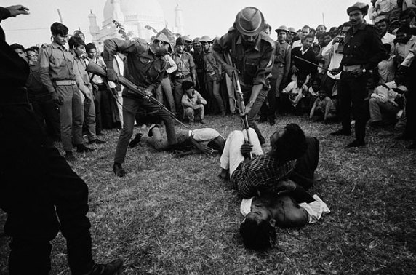
Military operation in East Pakistan
Resistance day March 23, 1971
Role of General Tikka Khan
Role of Pakistan army

Slide 9
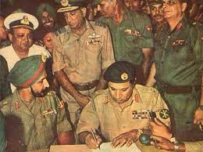
The Intrigues of super power
Indra Gandhi’s successful tour of Europe and USA
Military invasion of India

